Slide 1

College Database
By : Dattatri

Slide 2

Creating a database : A college database is a centralized system storing student, faculty, and administrative data. It tracks academic records, course information, and facilitates administrative tasks like admissions and financial management. This comprehensive tool enhances operational efficiency and supports decision-making processes within the institution.
CREATE DATABASE IF NOT EXISTS College ;
USE College ;

Slide 3

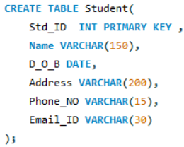
Creating a "student" table in a college database allows for systematic storage of student information like personal details, academic records, and enrollment status. It serves as a central repository for managing student data, facilitating administrative tasks such as enrollment, academic advising, and tracking student progress.
Query to create table:
Query to describe the table
DESC Student ;
FIELD | TYPE | NULL | KEY | DEFAULT | EXTRA
Std_ID | INT | NO | PRI | NULL
Name | VARCHAR(150) | YES |  | NULL
D_O_B | DATE | YES |  | NULL
Address | VARCHAR(200) | YES |  | NULL
Phone_NO | VARCHAR(15) | YES |  | NULL
Email_ID | VARCHAR(30) | YES |  | NULL

Slide 4
Teacher Table:
Creating a "teacher" table enables the systematic storage of information about faculty members, including their personal details, contact information, and teaching assignments. This table serves as a central resource for managing faculty data, facilitating tasks such as course assignment, scheduling, and communication between faculty and administration.
Courses Table:
The creation of a "courses" table allows for the organized storage of information about the courses offered by the college, including details such as course code, title, description, and credit hours. This table serves as a foundation for managing course information, facilitating tasks such as course registration, academic planning, and curriculum management.
Department Table:
Establishing a "department" table facilitates the structured storage of information about the various academic departments within the college, including department names, descriptions, and administrative contacts. This table serves as a centralized repository for managing departmental data, enabling tasks such as departmental organization, resource allocation, and reporting.
Enrollment Table:
Creating an "enrollment" table enables the systematic recording of student enrollment in courses, including details such as student IDs, course IDs, enrollment dates, and grades. This table serves as a key component for managing enrollment data, facilitating tasks such as course registration, academic advising, and tracking student progress throughout their academic journey.

Slide 5
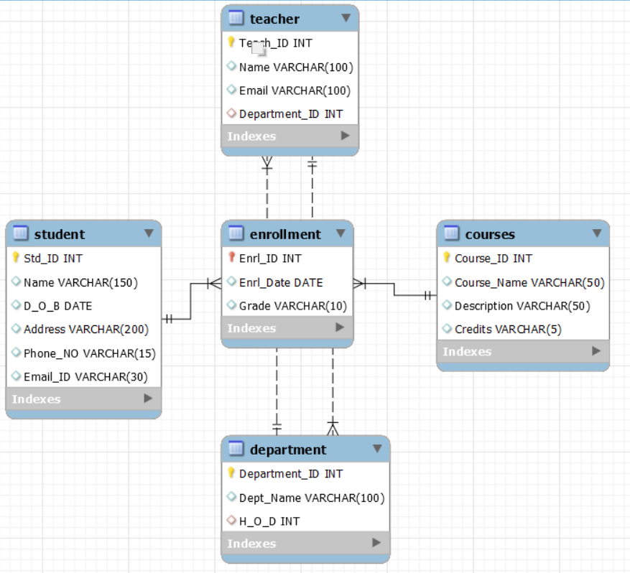
ER – Diagram of College Database

Slide 6
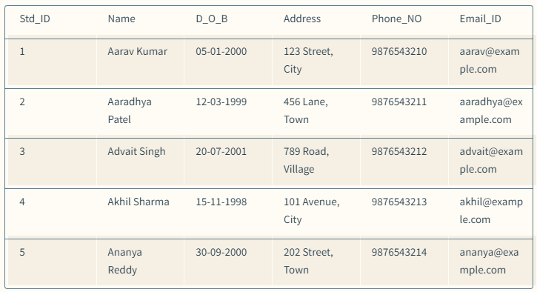
Query to Insert values into Student table
To view the Data from Student Table
INSERT INTO Student
( Std_ID, Name, D_O_B, Address, Phone_NO, Email_ID )
VALUES
(1, 'Aarav Kumar', '2000-01-05', '123 Street, City', '9876543210', 'aarav@example.com’),
(2, 'Aaradhya Patel', '1999-03-12', '456 Lane, Town', '9876543211', 'aaradhya@example.com’),
(3, 'Advait Singh', '2001-07-20', '789 Road, Village', '9876543212', 'advait@example.com’),
(4, 'Akhil Sharma', '1998-11-15', '101 Avenue, City', '9876543213', 'akhil@example.com’),
(5, 'Ananya Reddy', '2000-09-30', '202 Street, Town', '9876543214', 'ananya@example.com’);
SELECT * Student ;

Slide 7
Constraints
Primary Key :
A primary key is a field or a combination of fields in a table that uniquely identifies each record in that table.
It must contain unique values and cannot have NULL values.
There can be only one primary key in a table.
Primary keys are typically used as the basis for relationships with other tables (foreign keys).
Examples of primary keys could be a unique identification number for a person (like a social security number), a unique product code, or an auto-incrementing ID field.
Foreign Key :
A foreign key is a column or a set of columns in a table that references the primary key or a unique key in another table.
It establishes a link or relationship between two tables by referencing the primary key of one table from within another table.
Foreign keys help enforce referential integrity in a database, ensuring that relationships between tables remain consistent.
Unlike primary keys, foreign keys can have NULL values, allowing optional relationships between tables.
An example of a foreign key could be a "customer_id" column in an "orders" table that references the "customer_id" primary key column in a "customers" table.

Slide 8
Constraints
NOT NULL | UNIQUE | Default | CHECK
A not null constraint ensures that a column does not accept NULL values. It mandates that every row in the table must have a value for that column, preventing the insertion of rows with missing data in that specific column. | A unique constraint ensures that the values in the specified column(s) are unique across all records in the table. Unlike a primary key, a unique constraint allows NULL values, but only one NULL value per column | A default constraint specifies a default value for a column if no value is explicitly provided during an insert operation. It ensures that if a value is not supplied for the column, the default value is used instead. | A check constraint limits the values that can be placed in a column. It specifies a condition that each row must satisfy for the data to be valid. If the condition evaluates to false, the data insertion or update operation is rejected.
CREATE TABLE table_name ( column1 datatype NOT NULL, column2 datatype ); | CREATE TABLE table_name ( column1 datatype UNIQUE, column2 datatype ); | CREATE TABLE table_name ( column1 datatype DEFAULT default_value, column2 datatype;); | CREATE TABLE table_name ( column1 datatype, column2 datatype, ... CHECK (condition) );
CREATE TABLE customers ( customer_id INT NOT NULL, customer_name VARCHAR(50), ... ); | CREATE TABLE employees ( employee_id INT UNIQUE, employee_name VARCHAR(50), ); | CREATE TABLE employees ( employee_id INT PRIMARY KEY, employee_name VARCHAR(50), hire_date DATE DEFAULT CURRENT_DATE); | CREATE TABLE products ( product_id INT, product_name VARCHAR(50), price DECIMAL(10,2), CHECK (price > 0) );

Slide 9
Clauses
SELECT | FROM | WHERE | GROUP BY | HAVING | ORDER BY | LIMIT | OFFSET
Specifies the columns to be retrieved from one or more tables in a query result set. | Specifies the table(s) from which to retrieve data in a query. | Filters the rows returned by a query based on specified conditions. | Groups rows that have the same values into summary rows, typically for use with aggregate functions like SUM, COUNT, AVG, etc. | Filters group rows based on specified conditions in a GROUP BY clause. | Sorts the result set of a query by specified columns either in ascending or descending order. | Specifies the maximum number of rows to return in the result set. | Specifies the number of rows to skip before starting to return rows from the result set.
SELECT column1, column2 FROM table_name; | SELECT column1 FROM table_name; | SELECT column1 FROM table_name WHERE condition; | SELECT column1, COUNT(*) FROM table_name GROUP BY column1; | SELECT column1, COUNT(*) FROM table_name GROUP BY column1 HAVING COUNT(*) > 1; | SELECT column1, column2 FROM table_name ORDER BY column1 ASC; | SELECT column1, column2 FROM table_name LIMIT 10; | SELECT column1, column2 FROM table_name OFFSET 10;

Slide 10
Queries which can’t effect the schema
Update
delete
The UPDATE statement is used to modify existing records in a table.
UPDATE table_name
SET column1 = value1, column2 = value2, ...
WHERE condition;
UPDATE employees
SET department = 'IT'
WHERE department = 'HR';
The DELETE statement is used to remove existing records from a table.
DELETE FROM table_name
WHERE condition;
DELETE FROM employees
WHERE department = 'HR' AND hire_date < '2023-01-01';

Slide 11
Queries which can effect the schema
ALTER : command used to modify existing database objects such as tables, views, or indexes. It allows you to add, delete, or modify columns, constraints, or indexes in a table, change the table's structure, or rename the table itself. Here are some example
drop
The DROP column operation is used to remove an existing column from a table.
ALTER TABLE table_name
DROP COLUMN column_name;
ALTER TABLE employees
DROP COLUMN email;

Slide 12
Queries which can effect the schema
rename
modify
The RENAME column operation is used to rename an existing column in a table.
ALTER TABLE table_name
CHANGE old_column_name new_column_name
datatype [constraint];
The MODIFY column operation is used to change the data type or constraints of an existing column in a table.
ALTER TABLE table_name
MODIFY column_name new_datatype [constraint];

Slide 13
Joins in SQL
1. Inner Join: Returns rows that have matching values in both tables.
SELECT * FROM Student
INNER JOIN Teacher ON
Student.id = Teacher.id;
id | name | id | name | s_id
1 | Amar | 1 | Mrs. Kumar | 1
2 | Priya | 2 | Mr. Rao | 2
3 | Arun | 3 | Mrs. Reddy | 3
4 | Deepa | 4 | Mr. Sharma | 4
5 | Manjunath | 5 | Mrs. Patil | 5

Slide 14
Joins in SQL
2. Left Join : Returns all rows from the left table and the matched rows from the right table. If no matching rows found, NULL values are returned for the columns from the right table.
SELECT * FROM student
LEFT JOIN teacher
ON
student.id = teacher.id;
id | name | id | name | s_id
1 | Amar | 1 | Mrs. Kumar | 1
2 | Priya | 2 | Mr. Rao | 2
3 | Arun | 3 | Mrs. Reddy | 3
4 | Deepa | 4 | Mr. Sharma | 4
5 | Manjunath | 5 | Mrs. Patil | 5
6 | Ananya | NULL | NULL | NULL
7 | Ravi | NULL | NULL | NULL
8 | Divya | NULL | NULL | NULL
9 | Sanjay | NULL | NULL | NULL
10 | Shwetha | NULL | NULL | NULL

Slide 15
Joins in SQL
3. Right Join : Returns all rows from the right table and the matched rows from the left table. If no matching rows found, NULL values are returned for the columns from the left table.
SELECT * FROM student
RIGHT JOIN teacher
ON
student.id = teacher.id;
id | name | id | name | s_id
1 | Amar | 1 | Mrs. Kumar | 1
2 | Priya | 2 | Mr. Rao | 2
3 | Arun | 3 | Mrs. Reddy | 3
4 | Deepa | 4 | Mr. Sharma | 4
5 | Manjunath | 5 | Mrs. Patil | 5
NULL | NULL | 11 | Ms. Singh | 1
NULL | NULL | 12 | Mr. Desai | 2
NULL | NULL | 13 | Mrs. Menon | 3
NULL | NULL | 14 | Mr. Prasad | 4
NULL | NULL | 15 | Mrs. Gupta | 5

Slide 16
Joins in SQL
4. Full Join : FULL JOIN ensures that all rows from
both tables are included in the result set, regardless
of whether there is a matching row in the other table.
it combines the functionality of LEFT JOIN and RIGHT
JOIN, providing a comprehensive view of the data f
rom both tables.
SELECT * FROM student LEFT JOIN teacher
ON student.id = teacher.id
UNION
SELECT * FROM student RIGHT JOIN teacher
ON student.id = teacher.id;
id | name | id | name | s_id
1 | Amar | 1 | Mrs. Kumar | 1
2 | Priya | 2 | Mr. Rao | 2
3 | Arun | 3 | Mrs. Reddy | 3
4 | Deepa | 4 | Mr. Sharma | 4
5 | Manjunath | 5 | Mrs. Patil | 5
6 | Ananya | NULL | NULL | NULL
7 | Ravi | NULL | NULL | NULL
8 | Divya | NULL | NULL | NULL
9 | Sanjay | NULL | NULL | NULL
10 | Shwetha | NULL | NULL | NULL
NULL | NULL | 11 | Ms. Singh | 1
NULL | NULL | 12 | Mr. Desai | 2
NULL | NULL | 13 | Mrs. Menon | 3
NULL | NULL | 14 | Mr. Prasad | 4
NULL | NULL | 15 | Mrs. Gupta | 5

Slide 17

Thank You

